Slide 2
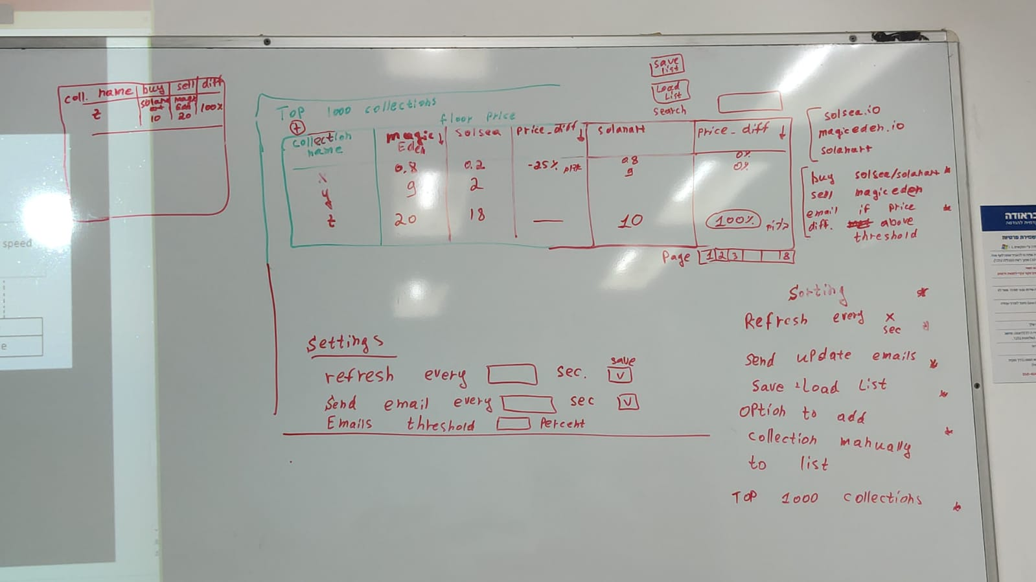

Slide 3
Pulling data async each x sec
API
Solsea.IO
Worker
Façade: getTopStocks(){
getSolsea()
getSolanart()
getMagicEden()
return List
}
API
solanart.IO
UI
Manager
API
magiceden.IO
Event
Logger
Singleton
Log
File
Mail Service

